Slide 1
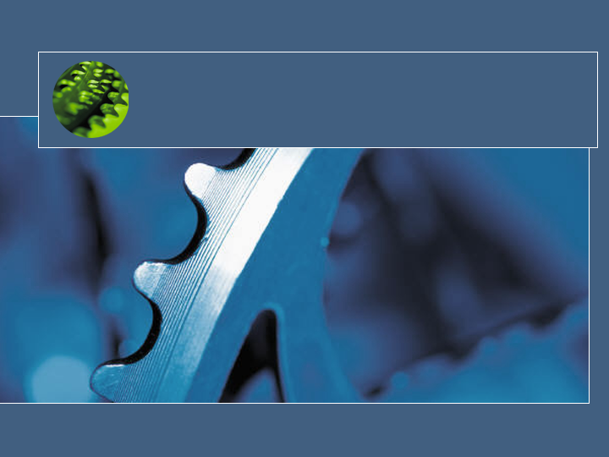
.NET Brown Bag
Lunch
Today’s Topic:
System Testing
using N-Unit
Presenter:
Tracy White from
TRO - Control Systems
Operations Applications
March 29, 2006

Slide 2
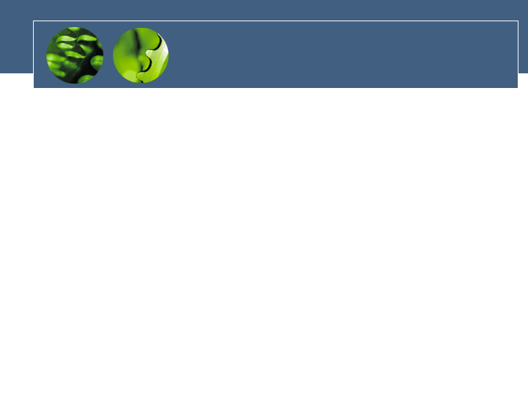
Welcome!
Welcome to the first meeting of TVA’s .NET brown bag lunch!
These monthly forums will allow us to engage multiple organizations within TVA for exchange of knowledge, new ideas and solutions related to .NET
Even if you just have a passing interest in development, please feel to come or invite anyone within TVA who you think might be interested. Thanks!

Slide 3
Today’s Agenda
Introductions
Presentation: .NET Application Testing using N-Unit
  For more info visit: http://www.nunit.org/)
Open Discussion
Next Month’s Topics:
  A multi-threaded process queue
  Control Systems applications demos

